Slide 1
Mini Project – 1

Slide 2
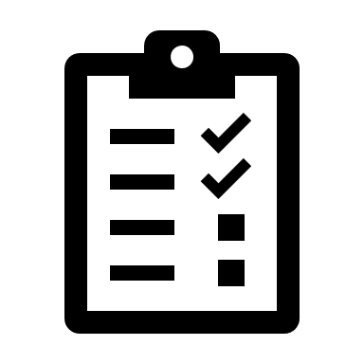
To-do list
A task manager you can trust

Slide 3
TEAM Our Team Members
M Nikhil Narasimha 737-025
M. Pawan Kalyan 737-027
R. Srujan Teja 737-046

Slide 4
Introduction
Every day we have thousands of thoughts running in our head, we feel like to grasping and trying to remember everything we’ve thought, but thoughts seem to slip away (it’s obvious) here comes the TO-DO LIST, as soon as we write down the thoughts scrambling around our head, we feel a sense of relief, your brain stops stressing about remembering everything, we can become more organized.
We can make it more flexible using latest technology

Slide 5
Abstract
Python being a powerful, flexible and easy to use language, offers powerful and efficient foundations for supporting projects​​
In our "To do list" project we are planning to use either of the modules Tkinter or Django
The UI contains a box with list of tasks, buttons to add a new task or delete an existing task, the tasks are tagged with checkboxes, we can check off the completed tasks, the checked off tasks will be transferred to another box/list . There will be a priority bar displaying the high priority task.

Slide 6
Features
User – friendly UI
Easy to use
Recurring tasks
Notes
Priority bar
Productivity Chart
Notifications (Not finalized)
Themes (Not finalized)
.

Slide 7


Existing Products
Google Tasks
Google Tasks lets you create a to-do list within your desktop Gmail or the Google Tasks app. When you add a task, you can integrate it into your Gmail calendar, and add details or subtasks
Microsoft to do
Microsoft To Do is a task management app to help you stay organized and manage your day-to-day tasks, we can use this app to take notes, list tasks or grocery list.
Google and Microsoft being the leading tech giants in the market provided some really great productivity tools like these.

Slide 8
Future scope
As we grow increasingly more connected through technology and social media, it is becoming more and more difficult to organize our lifestyle.
In this fast-changing world we are always busy, we become more busier as time passes, there arises the need of a to do list.
When we are often overwhelmed with tasks, writing them down makes our mind less stressed, it helps in increasing memory, prioritizing, and helps in increasing productivity.
They dampen anxiety about the chaos of life; they give us a structure, a plan that we can stick to; and they are proof of what we have achieved that day, week or month.
We believe this will a great tool for people living in this fast-changing corporate world to enhance their productivity

Slide 9

“Let's focus on what matters the most”

Slide 10

THANK YOU!
Presentation

